Slide 1
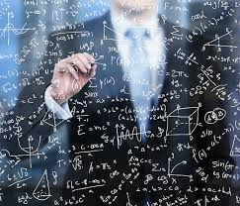
Data Scientist
WQD7001

Slide 2
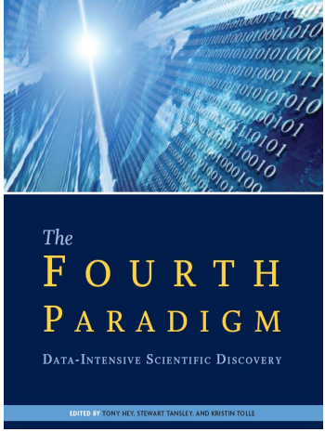
Fourth Paradigm of Science
Thousands of years
Empirical
Few hundreds of years
Theoretical
Last fifty years
Computational
“Query the world”
Last twenty years
eScience (data science)
“download the world”

Slide 3
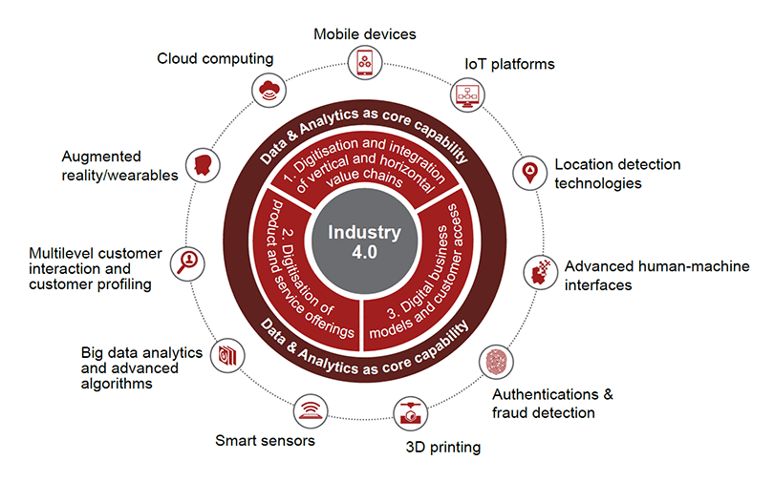
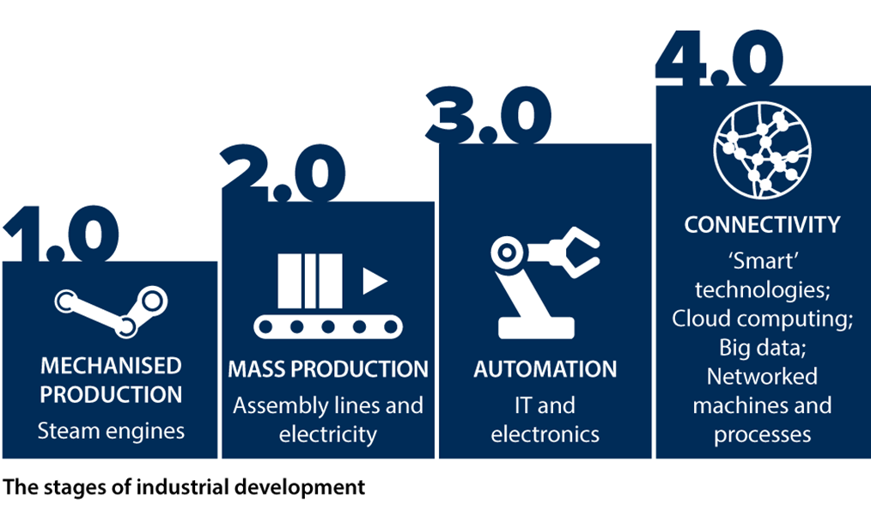
Coined by German economist Klaus Schwab in 2015, the Fourth Industrial Revolution is used to describe the emergence of the Digital Economy and use of automation and data exchange in industrial technologies.
No “Industry 4.0” without data analytics
Industry
For a factory or system to be considered Industry 4.0, it must include:
Interoperability — machines, devices, sensors and people that connect and communicate with one another.
Information transparency — the systems create a virtual copy of the physical world through sensor data in order to contextualize information.
Technical assistance — both the ability of the systems to support humans in making decisions and solving problems and the ability to assist humans with tasks that are too difficult or unsafe for humans.
Decentralized decision-making — the ability of cyber-physical systems to make simple decisions on their own and become as autonomous as possible.

Slide 4
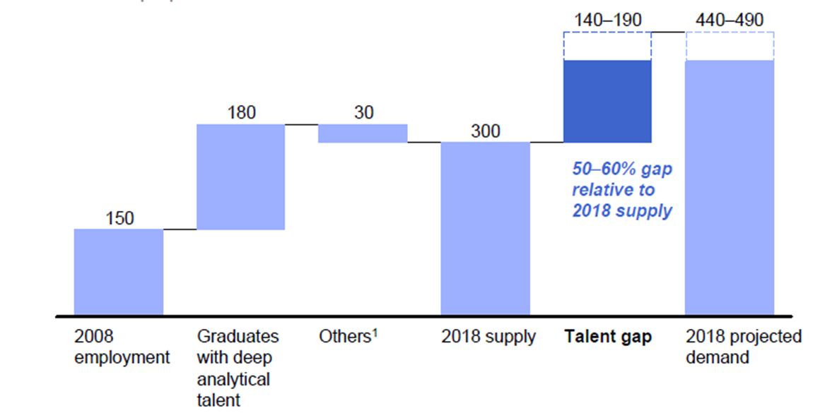
Data Scientist: New Profession and Opportunities
McKinsey Institute on Big Data Jobs (2011)
http://www.mckinsey.com/mgi/publications/big_data/index.asp
There will be a shortage of talent necessary for organizations to take advantage of Big Data.
By 2018, the United States alone could face a shortage of 140,000 to 190,000 people with deep analytical skills as well as 1.5 million managers and analysts with the know-how to use the analysis of big data to make effective decisions.
Malaysia Digital Economy Corp (MDEC) targets to have 20,000 big data professionals by 2020.

Slide 5
MALAYSIA CONTINUES TO GROOM DATA PROFESSIONALS
During Big Data Week Kuala Lumpur 2018 (4th Oct), it was announced that Malaysia currently has around 8,000 professionals in big data, and it is on track in achieving the target of 20,000 data professionals by year 2020.
In the effort to embrace the fourth industrial revolution, Malaysia now needs to prepare its talent for AI.
Data professionals need to be equipped with the know-how of Artificial Intelligence.

Slide 6
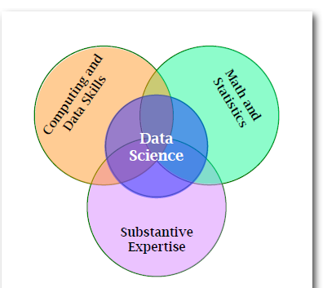
Some tasks that might reasonably be labeled as part of doing data science.
Table 1. Representative data science tasks and the portion of the Data Science Venn diagram from which they primarily draw. (CD = Computing and Data Skills, MS = Math and Statistics, SE = Substantive Expertise)
What constitutes data science?
Task | Primary Expertise
Set up a server as a repository of data streaming in real time from a large array of geographically distributed sensors. | CD
Explain the origin of outliers in a particular data set. | SE
Decide to what extent the conclusions drawn from analysis can be generalized. | MS
Design a data visualization suitable for publication in an article for non-experts. | CD
Decide what data should be gathered. | SE
Decide whether certain disparate data sets can be meaningfully merged. | SE
Automate the merger of multiple data sets. | CD
Detect the signal within the noise. | MS
Reduce the number of variables that need to be considered for a particular analysis. | MS
Set up a version management system for data that will be gathered over a number of years. | CD
Fig 1. Data Science Venn diagram adapted from Conway (2010)
Conway, D. (2010). The data science venn diagram. Dataists [Web page].
Retrieved September 9, 2016, from http://www.dataists.com/2010/09/the-data-science-venn-diagram/

Slide 7
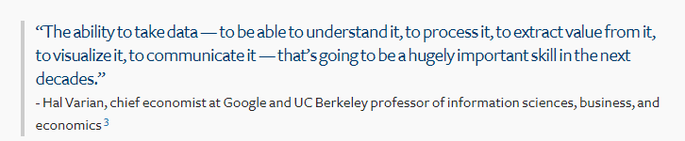

Slide 8
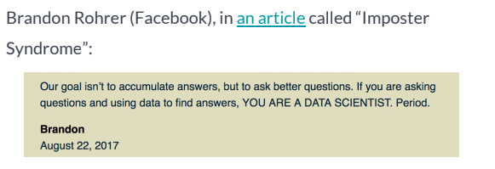
Everyone else in DS field is more qualified than me!!!
https://brohrer.github.io/imposter_syndrome.html
There are two paths forward: Generalist and Specialist.
A good generalist
is superficially familiar with every part of data science, recognizes all the jargon and technical terms, has a good notion of what tools and expertise are needed to solve a given problem, and asks insightful questions in technical reviews.
A good specialist
understands one area deeply, can explain their area of expertise to non-experts, understands the tradeoffs between different approaches, is up to date on current research and new tools, and can use their tools quickly to produce high-quality results.

Slide 9
Navigating the Sprawling Terrain of Data Science
The reason data science feels so big is because it’s no longer a single field. There are actually three separate pillars.
Data Analysis - turning raw information into knowledge that can be acted on.
Data Modeling - using the data we have to estimate the data we wish we had.
Data Engineering - making everything work faster, more robustly, and at greater scale.

Slide 10
Data Analysis
There are several aspects of data analysis, the process of taking data and turning it into information that we can use to make a decision.
Domain knowledge - translate a business need to a question, make accuracy-cost trade-offs.
Research - gather the data, design and conduct experiments.
Interpretation - Summarize and aggregate, visualize, apply statistical tools

Slide 11
Data Modeling
Data modeling also has several major subcategories, often referred to as machine learning.
Creating a simplified description of your data that you can use to make estimates for data that you have not measured.
Supervised learning - classification, regression, anomaly detection
Unsupervised learning - clustering, dimensionality reduction, anomaly detection
Custom algorithm development - feature engineering, numerical optimization

Slide 12
Data Engineering
Data engineering is the third pillar of data science. It has a few major areas.
Data management - is the exercise of storing, moving, and handling data.
Include data base management, pipeline construction, data collection.
Production – taking code that works well in a prototype and making it ready for operation in the wider world.
e.g. automation, system integration, robustification
Software engineering - ensure maintainability, scaling, collaborative development

Slide 13
Data Mechanics
This is the dirty work that everyone needs to do but nobody likes to talk about.
Data formatting - type conversion, string manipulation, fixing errors
Value interpretation - handling dates and times in an interpretable and consistent way, responding correctly to missing values, making sure units of measurement are consistent and documented
Data handling - querying, slicing, joining.
This lets you pull the subset of data that you want for an operation from the great lake of what you have available.

Slide 14
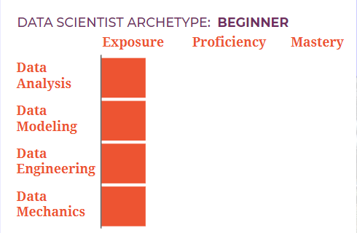
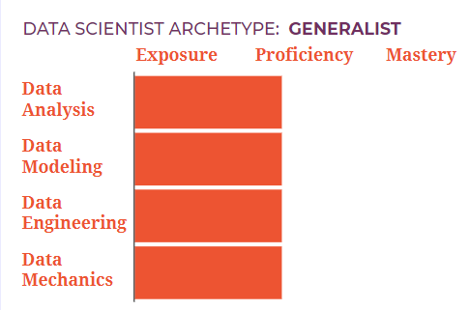
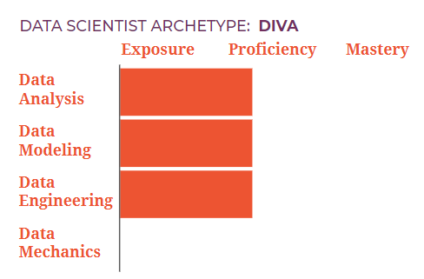

Slide 15
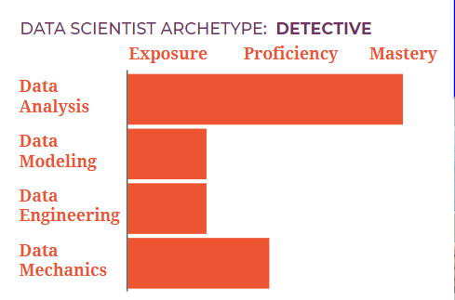
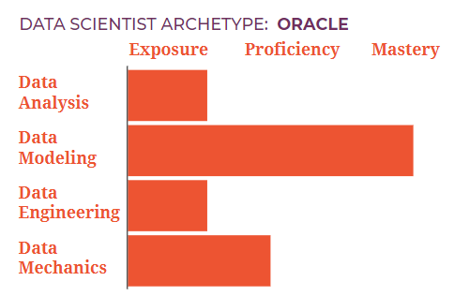
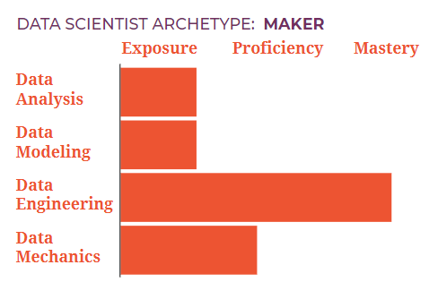

Slide 16
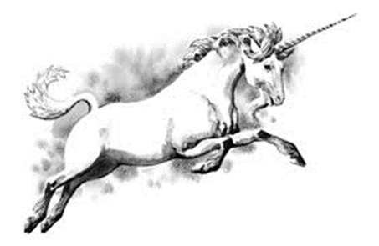
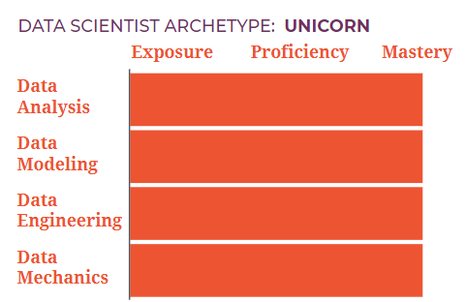
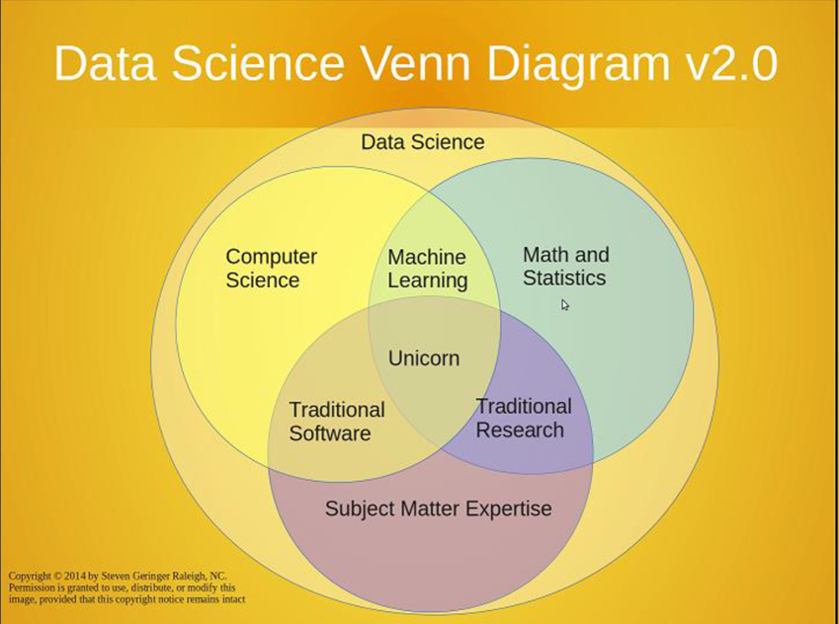
“Unicorn Data Scientists (upgraded from “sexy data scientists”) are hard to find …” - Gil Press, Forbes, 2015

Slide 17
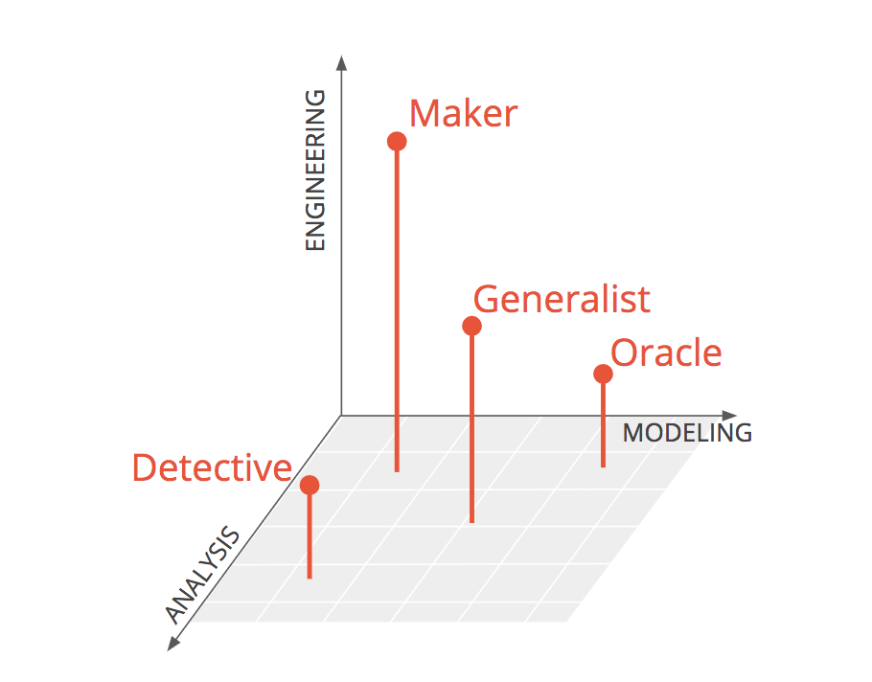
DATA SCIENTIST ARCHETYPES
What kind of data scientist do you want to be?
Generalist (proficient at everything)
Detective (mastery of analysis)
Oracle (mastery of modeling)
Maker (mastery of engineering)
https://brohrer.github.io/data_science_archetypes.html

Slide 18
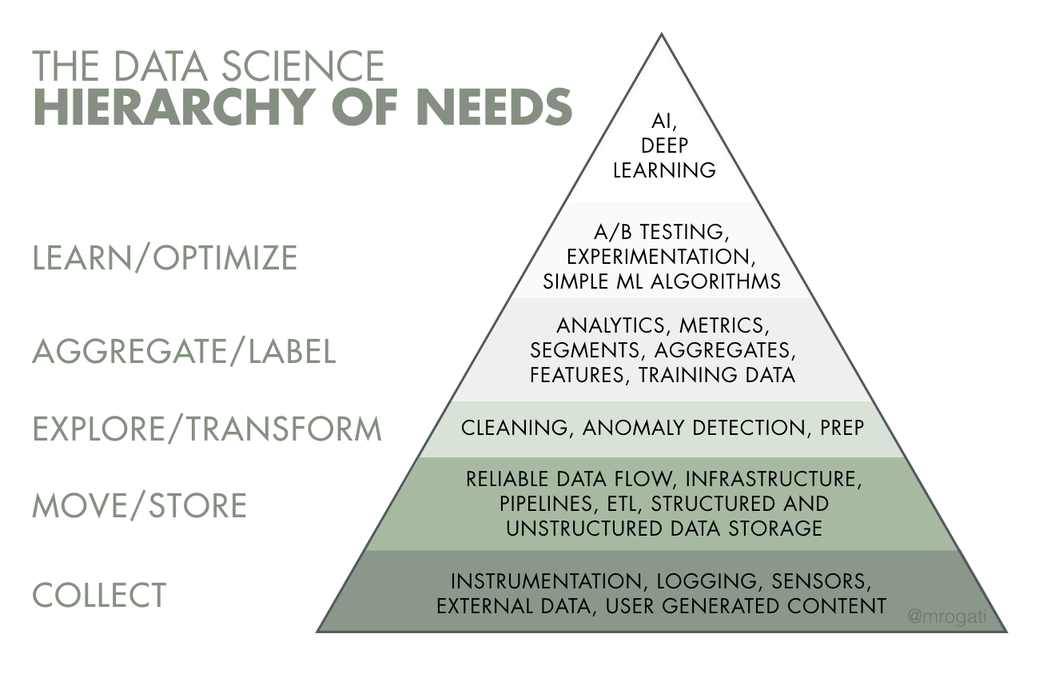
It is time to test machine learning and artificial intelligence solutions.
Simple machine learning algorithms like logistic regression are also recommended at this stage to ensure all needed insights are included in the dataset.
Determine what you ultimately want to predict or learn and what components of the insight will help you reach your goal.
This includes data cleansing, as well as digging deep into the data to ensure you have all of the data needed to reach your ultimate goal.
Do you have reliable streams / ETL ? Where do you store it, and how easy is it to access and analyze?
At the bottom of the pyramid we have data collection. What data do you need, and what’s available?
https://hackernoon.com/the-ai-hierarchy-of-needs-18f111fcc007

Slide 19
What Skills Make Data Scientists Exceptional?
Beyond technical proficiency, there are several skills that a data scientist must have to excel.
Communication
In their writing, presentations and emails strong data scientists are clear.
They focus on the audience, considering what they already know, what they need to know and what they care about.
They can explain their methods and results to a non-technical audience at the appropriate level of technical depth.
Data scientists that are lacking in this area fail to convey their work or persuade teammates and leaders of its importance.

Slide 20
Breadth
Strong data scientists are not afraid to move between roles, say, migrating between data analysis, data engineering, modeling, and back, over the course of a project.
This breadth provides a huge benefit. For example, doing data analysis while keeping the limitations of modeling in mind produces results that are more accurate, more useful and more timely.
Data scientists that are lacking in this area might say "I'm a modeler. Data cleaning is a job for someone else." Overspecialization leads to blind spots, such as neglecting code health or neglecting statistical rigor.

Slide 21
Readiness to learn new tools, skills and domains
There's no practical way to learn all the tools you will need before you need them. The only way to be prepared for this is get comfortable with the process of learning.
The set of tools a data scientist comes with doesn't matter as much as their ability to embrace new ones.
Data scientists that are lacking in this area will be limited in what they can contribute. Most project work will be frustrating. (Their teammates will be frustrated too.) The solution is to adopt a willingness to feel dumb, also known as "a beginner's mindset". This helps navigate the uncomfortable start-up period when every step of working with a tool is unfamiliar. The beginner's mindset manifests itself as a curiosity about the field, the company, the products, and the customers.

Slide 22
Success Patterns
Learning through practice
Have a broad understanding of all the roles a data scientist can play and have deep skills in at least one.
These data scientists are the ones who have worked on realistic data science problems in several domains.
Concrete examples with rich context and ambiguity are powerful teachers. Applying the same skill in several different domains bestows a facility on the learner that is hard to get any other way.
Mentoring / cross-mentoring / community contribution
Share your work with others in the form of teaching activities with those less experienced, such providing advice, tutorials, or explanations.
It can also manifest between peers in such varied ways as publishing project summaries, asking advice, cooperative coding, and creating cheat sheet references for a new tool. These can take place in person or on-line.
Every major social network has its own data science community, each with its own flavor.

Slide 23
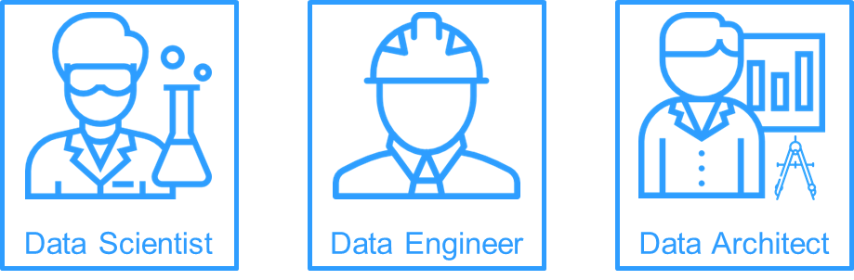
Solution to Replace Unicorn Data Scientist
Data Science Team
Build out teams to reflect a variety of backgrounds and experience.
A data science team can have various roles like data engineer, data analyst, business intelligence, research scientist, decision scientist, and of-course data scientist.

Slide 24
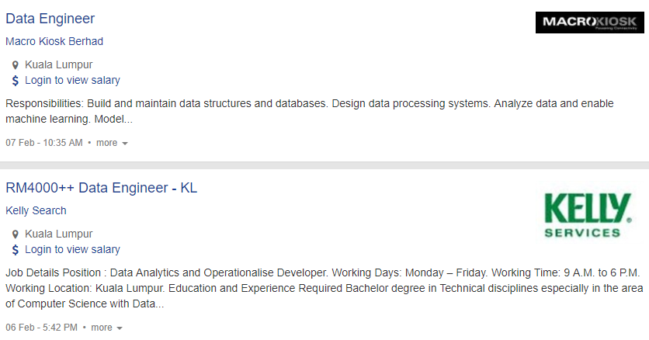

Slide 25
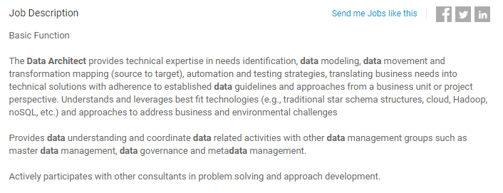

Slide 26
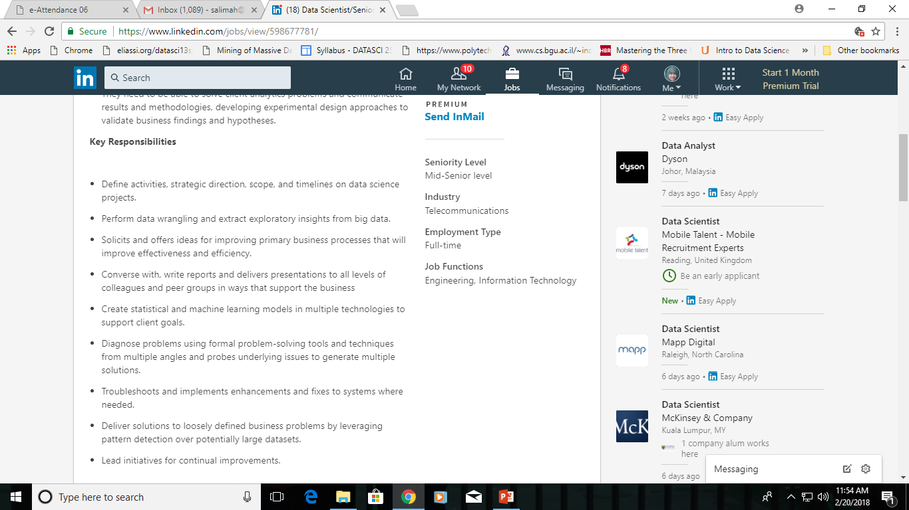
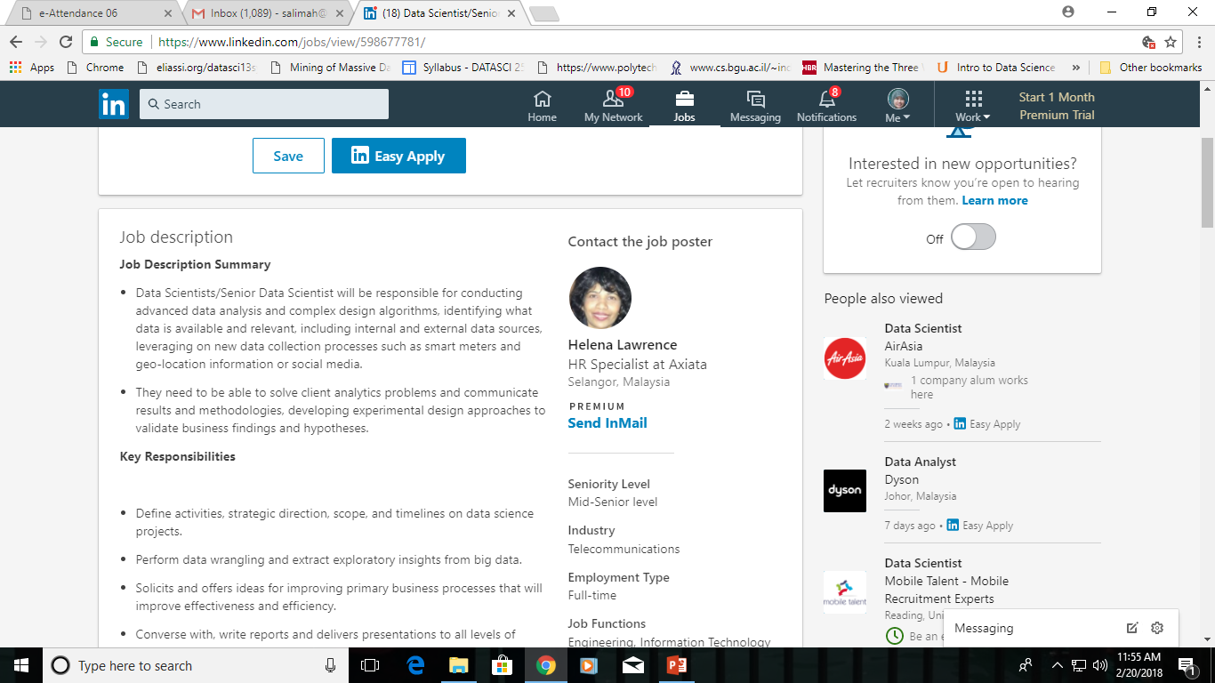

Slide 27
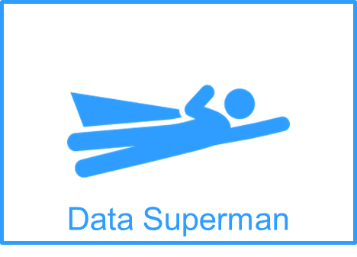
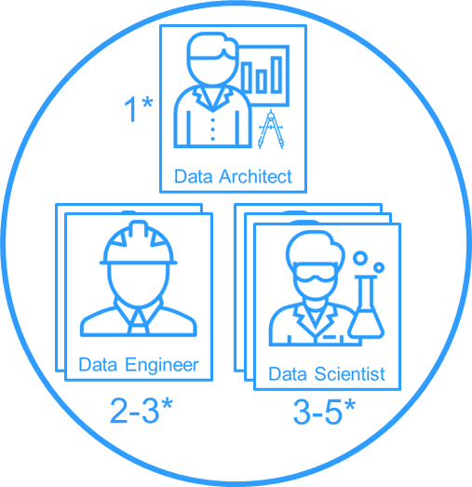
Ideal Scenario
Reality
Learn how to use the whole data toolbox He must be able to face the majority of IT challenges by yourself, from bash to Dockerfile.
Learn how to explain your work A good story with average results is better than a boring story with good results (stunning results always win).
Learn how to write “good code” Working like the person you are going to show your code one day is a psychotic killer.
Learn how to understand business needs Well posed questions are very rare.
Learn how to make models work Data Superman needs to be comfortable with mathematics and statistics.
1 Data Architect/Data team manager
2-3 Data engineer to support the development and go-lives
3-5 Data Scientist for fast prototyping and complex models/analysis

Slide 28
Vertical Data Scientist
Vertical data scientists are the by-product of a university system that trains a person to become a computer scientist, a statistician, an operations researcher, or an MBA.

Slide 29
Vertical Data Scientist
Vertical data scientists have deep technical knowledge in some narrow field. For instance:
Computer scientists familiar with computational complexity of all sorting algorithms.
Statisticians who know everything about eigenvalues, singular value decomposition and its numerical stability, and asymptotic convergence of maximum pseudo-likelihood estimators.
Software engineers with years of experience writing Python code (including graphic libraries) applied to API development and web crawling technology.
Database specialists with strong data modeling, data warehousing, graph database, Hadoop, and NoSQL expertise.
Predictive modelers with expertise in Bayesian networks, SAS, and SVM.

Slide 30
Horizontal Data Scientist
Horizontal data scientists are a blend of business analysts, statisticians, computer scientists, and domain experts. They combine vision with technical knowledge.
Have cross-discipline knowledge, including some of computer science, statistics, databases, machine learning, Python, and, of course, domain expertise.

Slide 31
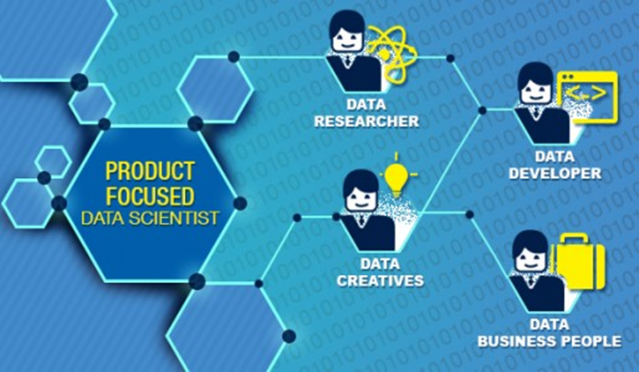
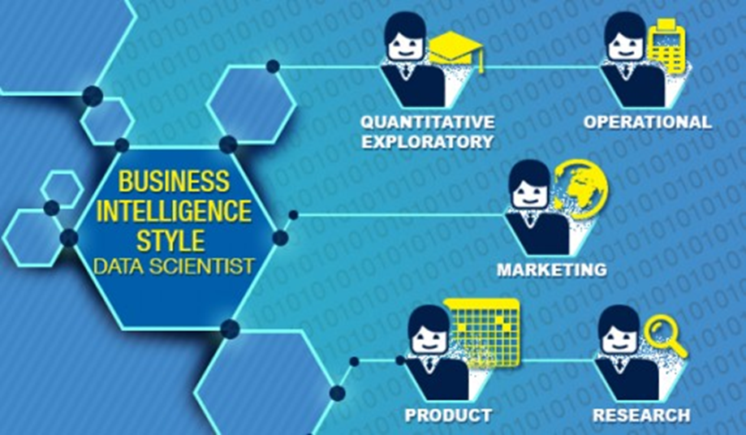
Data scientists can be classified into two categories
https://www.edureka.co/blog/types-of-data-scientists/

Slide 32
Product-focused Data Scientist
Data Researcher - Nearly 75% of Data Researchers have published in peer-reviewed journals and over half have a PhD. These are folks who are innovating data science at its most fundamental level.
Data Developer - Focused on the technical problem of managing data — how to get it, store it, and learn from it. At the entry level you’ll be working with Hadoop as well as structured data. If you are more interested in the data science infrastructure side this may be for you and is a particularly good path for a current analyst and IT staff to move up into the data science career path.
Data Creatives – those who make something innovative out of mountains of data. They are strongly skilled in machine learning, Big Data, programming and other skills to handle massive data.
Data Business people - are those that are most focused on the organization and how data projects yield profit. At the entry level you’ll be performing the junior duties of blending and cleaning data and preparing basic predictive models.

Slide 33
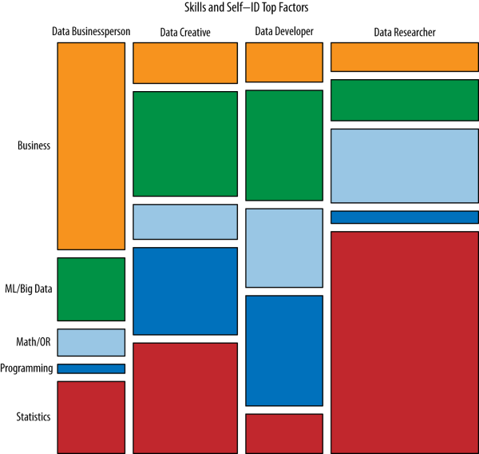

Slide 34
Business Intelligence Style Data Scientist
Quantitative, exploratory Data Scientists - are inclined to have PhDs and use theory to comprehend behavior. By combining theory and exploratory research, these data scientists improve products.
Operational Data Scientists - frequently work in finance, sales or operations teams in an organization. His role is to analyze performance, responses and behavior of a process, to improve organization’s strategy and efficiency.
Product Data Scientists - fit in to product management or engineering. Their job is to sift through logs and analysis tools, to understand the way users make use of a product and make use of that knowledge to fine tune the product.
Marketing Data Scientists - focuses on the user base, evaluate performance and work on improving efficiency, pretty much like the standard marketing guy.
Research Data Scientists - create insights from a data set. It’s rare for start-ups companies to employ research scientists because the output isn’t tied to profits. But larger companies, think tanks and financial institutions do.

Slide 35
Data science websites attract highly educated, wealthy males, predominantly with Asian origin, living mostly in the United States.
Web traffic statistics and demographics for the most popular data science websites, based on Quantcast.com
The United States leads in the number of visitors to data science websites.
Visitors from India are the second most frequent,
A few places that have experienced recent growth in data science professionals include Ireland, Singapore, and London.

Slide 36
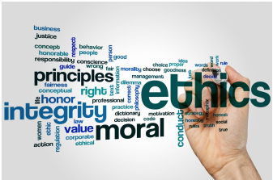
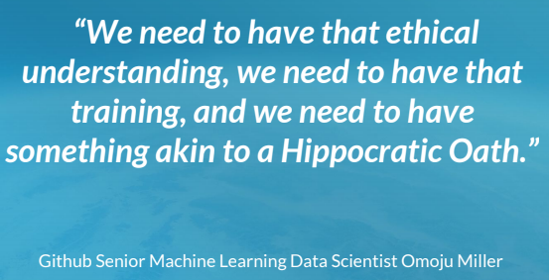
Ethics of Data Science
Need a consensus that ethical standards need to come form within data science itself, as well as from legislators, grassroots movements and other stakeholders.

Slide 37

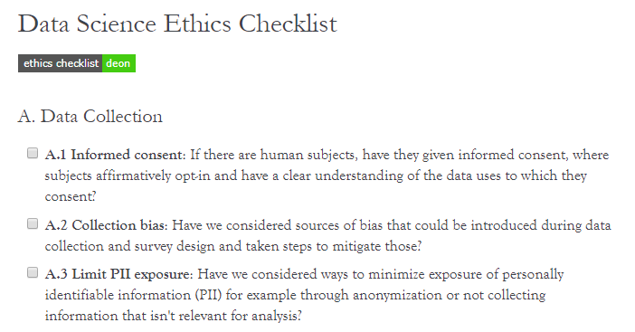
DrivenData has put together Deon, a command line tool, that allows you to easily add an ethics checklist to your data science projects.

Slide 38
3 Education options - A Career as a Data Scientist
Degrees and graduate certificates provide structure, internships, networking and recognized academic qualifications for your résumé. They will also cost you significant time and money.
MOOCs and self-guided learning courses are free/cheap, short and targeted. They allow you to complete projects on your own time – but they require you to structure your own academic path.
Bootcamps are intense and faster to complete than traditional degrees. They may be taught by practicing data scientists, but they won’t give you degree initials after your name.

Slide 39
Training for Data Science
A few universities and other organizations have started to offer data science degrees, training, and certificates.
University of Washington (Seattle, WA)
Northwestern University (Evanston, IL)
UC Berkeley (Berkeley, CA)
CUNY (New York, NY)
New York University (New York, NY)
Columbia University (New York, NY)
Stanford University (Palo Alto, CA)

Slide 40
Training for Data Science
Corporate and Association Training Programs
A few other types of organizations — both private companies and professional organizations — offer certifications or training.
INFORMS (Operations Research Society): Analytics certificate
Digital Analytics Association: certificate
TDWI (The Data Warehousing Institute): Courses; focus is on database architecture
American Statistical Association: Chartered statistician certificate
Data Science Central: Data science apprenticeship
International Institute for Analytics: More like a think tank. Founded by the famous Tom Davenport (visiting Harvard Professor and one of the fathers of data science).
Statistics.com: Statistics courses

Slide 41
Training for Data Science
Free Training Programs
Coursera.com
Machine Learning (Stanford University)
Web Intelligence and Big Data (Indian Institute of Technology)
Introduction to Data Science (University of Washington)
Maps and Geospatial Revolution (Penn State)
Introduction to Databases (Stanford University, self-study)
Computing for Data Analysis (Johns Hopkins University)
Statistics One (Princeton University)
Data Science Central
Training basics
Tutorials
Data sets
Real-life projects
Sample source code

Slide 42
Real World Experience
To develop a "real world experience" in data science is by working through lots of small projects.
Follow the process of
finding a data set you are interested,
asking and trying to answer questions about it,
write up the results, and
rinse and repeat to develop "real world experience".
https://www.datascienceweekly.org/articles/the-simple-process-to-get-real-world-data-science-experience

Slide 43
Data Science Portfolio
4 components:
Candidate’s particulars, like in CV.
Candidate’s DS knowledge & skills & attitude
Candidate’s real world experience doing DS work
Candidate’s contribution on DS, like participating in competition, bootcamp, talk, etc.

Slide 44
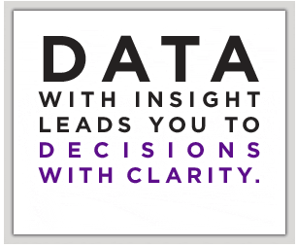
Ideas on Data Science Project
http://www.data.gov/applications.
http://www.datakind.org/projects
https://theartandscienceofdata.wordpress.com/2017/06/01/the-billionaire-clusters/
http://demos.datasciencedojo.com/

Slide 45


